Slide 1

MIS 637 – Machine Learning & Data Analytics Entrepreneur Data Prediction
Final Term Project
Spring’21
Malarvizhi Shanmuga Pandian

Slide 2
Table of Contents
Introduction
CRISP-DM
Business Understanding
Data Understanding
Data Source
Sample Data
Data preparation
Attribute Selection
Missing values
Attribute Transformation
Feature Scaling
Modeling
Evaluation
Confusion Matrix
Metrics
ROC Curve
Deployment
References

Slide 3
Introduction
It is important for banks and investment firms to do the right investment in business at the right time. Direct marketing to the right set of people will help the firms achieve the expected output in shorter time.
Only less than one percent of people are the entrepreneurs according to the census data.
There are always research conducted to indicate the evolution of new businesses specific to industry or regions or even towns. The reports are studied to understand the pattern and economical status of the population.

Slide 4
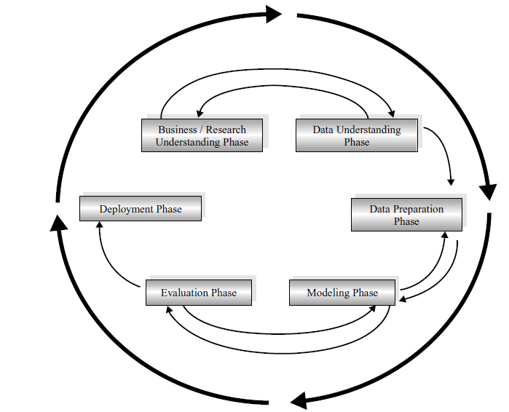
Crisp-DM Cross Industry Standard Process
There are totally 6 phases to complete modelling a project. They are:
Business understanding phase.
Data understanding phase
Data preparation phase
Modeling phase
Evaluation phase
Deployment phase

Slide 5
Business Understanding
Profound Question
Using the current population survey data about employment and education data, can we predict if an individual is a potential entrepreneur or not?
Goal
The goal is to categorize an individual for entrepreneurship by deriving rules and patterns from existing people data
Accomplishments
This model can be used by banks and investment firms to identify people to approach them for small business loans and investments

Slide 6
Data Understanding Data Source
The historical Kauffman Index microdata is consolidation of 650,000 observations of US adults.
The variables include entrepreneurship, age, race, gender, immigrant status, education, industry, state of residence, and many additional work, demographic, and geographical characteristics.
Data collected between years 2019 - 2020 is only taken into consideration for this project
https://people.ucsc.edu/~rfairlie/data/microdata/

Slide 7
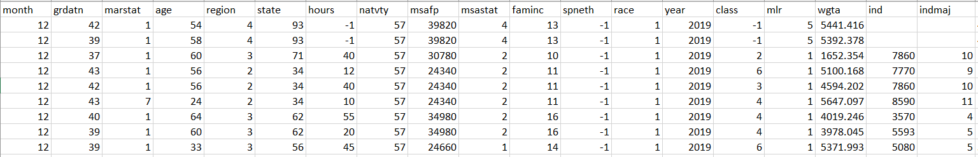
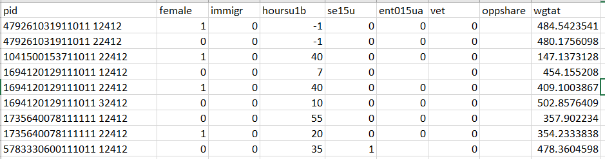
Data Understanding Sample Data

Slide 8
Data Understanding Attribute Description (1)
Variable | Description
age | age
class | class of worker
ent | entrepreneurship
faminc | total family income
female | female
grdatn | educational attainment
hours | total hours worked last week
hours | usual weekly hours at main job
immigr | immigrant
Refer the file kieacodebook_v8.xls in link for code book

Slide 9
Data Understanding Attribute Description (2)
Variable | Description
ind | industry for main job
indmaj | major industry for main job
marstat | marital status
mlr | monthly labor force recode
month | survey month
msafp | metropolitan area
msastat | central city status
natvty | country of birth

Slide 10
Data Understanding Attribute Description (3)
Variable | Description
oppshare | opportunity entrepreneur
pid | person identification code
race | race
region | region of the country
schenroll | enrolled in school
semp | self-employed with 15+ hours worked
spneth | Spanish ethnicity

Slide 11
Data Understanding Attribute Description (4)
Variable | Description
state | state
vet | veteran status
wgta | monthly sampling weight adjusted for matching - use for standard microdata analysis
wgtat | annual sampling weight adjusted for allocated observations for se15ua - use with year
year | survey year
state | state

Slide 12
Data Preparation Attribute selection
Few attributes are removed as follows:
PID – Person Identification code does not affect the output of the model
OPPSHARE - Opportunity entrepreneur is more of an assumption and the value is blank for around 90 percent of the dataset rows.
IND – Industry of main job is a support field of INDMAJ and with too many categories to make it difficult to transform
WGTAT, WGTA – Sampling weights calculated annually and monthly respectively. This attribute does not affect the output of the model
MSAFP – Metropolitan area – Subcategory of MSASTAT.
SPNETH – Spanish ethnicity does not affect the output of the model
MONTH, YEAR – Month, Year field does not affect the output of the model

Slide 13
Data Preparation Handling missing values
There are missing values in fields ENT, and INDMAJ and these rows were deleted from the dataset.
MSASTAT (Central city status) field has Not Identified instances (code = 4) and those rows are removed from the dataset.

Slide 14
Data Preparation Attribute Transformation
Family Income (FAMINC) | Current code | New code
<$5000 | 1 | 1
$5000-7499 | 2 | 2
$7500-9999 | 3 | 2
$10000-12499 | 4 | 3
$12500-14999 | 5 | 3
$15000-19999 | 6 | 3
$20000-24999 | 7 | 4
$25000-29999 | 8 | 4
$30000-34999 | 9 | 5
$35000-39999 | 10 | 5
$40000-49999 | 11 | 6
$50000-59999 | 12 | 7
$60000-74999 | 13 | 8
$75000-99999 | 14 | 8
$100000-149000 | 15 | 9
$150000+ | 16 | 10
Education (GRDATN) | Current code | New code
<first grade | 31 | 1
1st, 2nd, 3rd, or 4th grade | 32 | 1
5th or 6th grade | 33 | 1
7th or 8th grade | 34 | 1
9th grade | 35 | 1
10th grade | 36 | 1
11th grade | 37 | 1
12th grade, no diploma | 38 | 1
High school graduate - diploma | 39 | 1
Some college but no degree | 40 | 1
Associate degree - occupational/vocational | 41 | 2
Associate degree - academic program | 42 | 2
Bachelor's degree | 43 | 2
Master's degree (eg MA MS) | 44 | 3
Professional school deg (eg: MD DDS) | 45 | 3
Doctorate degree (eg: PhD EdD) | 46 | 3
Employment (MLR) | Current code | New code
Working | 1 | 1
With job, not at work | 2 | 1
Looking | 4 | 2
Layoff | 3 | 2
Retired | 5 | 2
Disabled | 6 | 2
Other | 7 | 2
Few attributes consist of too many categories, and it is required to reduce categories for a better modelling.
Employment (MLR) | Current code | New code
Working | 1 | 1
With job, not at work | 2 | 1
Looking | 4 | 2
Layoff | 3 | 2
Retired | 5 | 2
Disabled | 6 | 2
Other | 7 | 2
Marital Status (MARSTAT) | Current code | New code
Married, spouse present | 1 | 1
Married, armed forces spouse present | 2 | 1
Married, spouse absent (excl sep) | 3 | 1
Widowed | 4 | 2
Divorced | 5 | 2
Separated | 6 | 2
Never married | 7 | 2
Nationality (NATVTY) | Current code | New code
United States | 57 | 1
Other than US | 60 - 555 | 0

Slide 15
Data Preparation Attribute Transformation
Encoding independent variable
Categorical attributes are encoded into binary values resulting into a unique value for every category.
For instance, the attribute GRDATN having three categories are split into three columns in the dataset denoting one possible value of one category. The values for category [1,2,3] in the three columns are [(1,0,0), (0,1,0), (0,0,1)]
Categorical encoding is done using One-Hot encoder method for the attributes MONTH, GRDATN, MARSTAT, REGION, STATE, NATVTY, MSASTAT, FAMINC, RACE, YEAR, CLASS, MLR, INDMAJ.

Slide 16
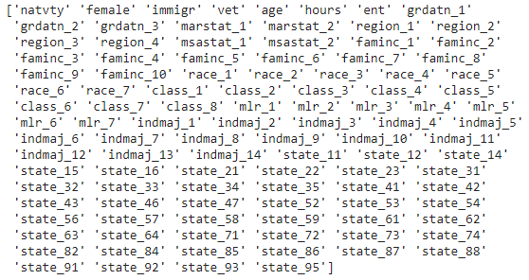
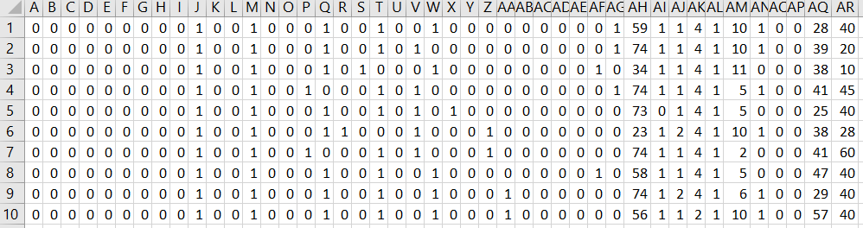
Data Preparation Attribute Transformation
Encoding independent variable
Column names:
Column values:

Slide 17
Data Preparation Data Splitting
Total records after data cleaning is 440,530
This dataset is split into two: Training set and Test set
Training set – 75% of the total rows (330,398 rows) is used to train the model
Test set – 25% of the total rows (110,132 rows) is used for evaluating the trained model

Slide 18
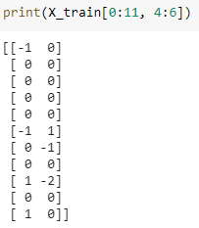
Data Preparation Feature Scaling
Feature scaling is a method used to normalize the range of independent variables.
Since, the values are in different ranges like AGE, HOURS(continuous value) than the other independent variables with binary values.
The values are standardized using Z-Score normalization method using X* = (X – σ) / μ​ where μ is the mean value of the feature and σ is the standard deviation of the feature.
The values lies between -3 and 3. Few rows of AGE and Hours column is printed.

Slide 19
Data Preparation Over-Sampling using SMOTE
In the training data, the number of records of entrepreneurs and non-entrepreneurs is in an imbalanced proportions.
Using SMOTE algorithm (Synthetic Minority Oversampling Technique), we can up-sample the entrepreneurs records to create a balanced sampling.
Works by creating synthetic samples from the minor class (entrepreneur-> ENT=1) instead of creating copies.
Randomly choosing one of the k-nearest-neighbors and using it to create a similar, but randomly tweaked, new observations.
Implemented the algorithm using class imblearn.over_sampling.SMOTE in Python. Find below the result:
/usr/local/lib/python3.7/dist-packages/sklearn/utils/validation.py:760: DataConversionWarning: A column-vector y was passed when a 1d array was expected. Please change the shape of y to (n_samples, ), for example using ravel(). y = column_or_1d(y, warn=True) /usr/local/lib/python3.7/dist-packages/sklearn/utils/deprecation.py:87: FutureWarning: Function safe_indexing is deprecated; safe_indexing is deprecated in version 0.22 and will be removed in version 0.24. warnings.warn(msg, category=FutureWarning)
length of oversampled data is 657844
Number of no subscription in oversampled data 328922
Number of subscription 328922
Proportion of no subscription data in oversampled data is 0.5
Proportion of subscription data in oversampled data is 0.5

Slide 20
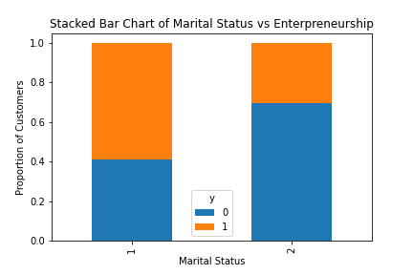
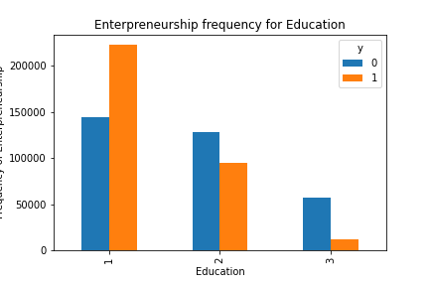
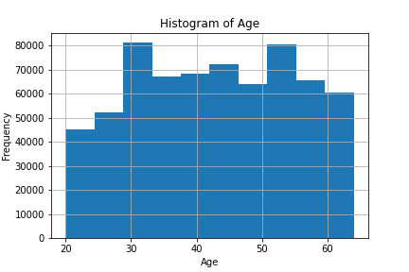
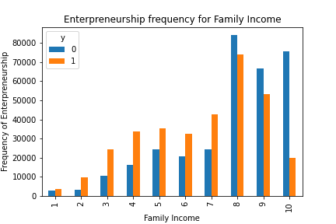
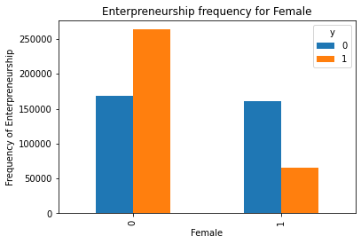
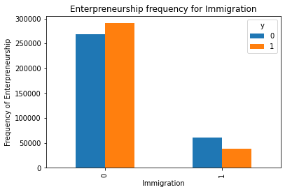

Modelling Visualization

Slide 21


Modelling Algorithm used
The target variable in the dataset is a categorical value i.e. (Yes or No). Therefore, it is the best option to use Classification models to determine the values in target field (ENT)
Among classification models, to predict binary dependent variable, there are two algorithms – Logistic Regression and C4.5 Decision Tree that tends to preform well with its own pros and cons. Both the algorithms can be used in our dataset and decide which can be deployed based on the accuracy rate
Modelling is performed in Python language using Sci-Kit learn libraries.
Logistic Regression: Logistic regression is a statistical model that in its basic form uses a logistic function to model a binary dependent variable, although many more complex extensions exist. The logistic is a sigmoid function, which takes any real input t, and outputs a value between zero and one.
C4.5 Decision Tree: C4.5 recursively visits each decision node, selecting the optimal splits, until no further splits are possible. It makes use of the concept of information gain or entropy reduction to select the optimal split.

Slide 22
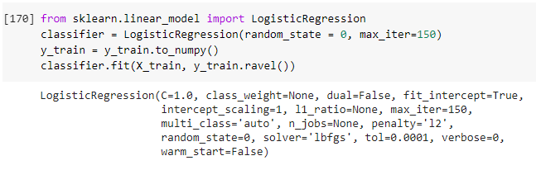
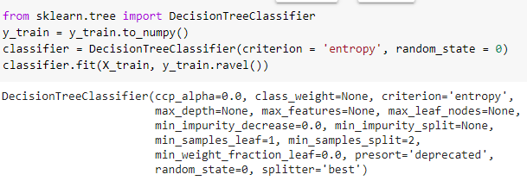
Modelling Code Execution
Logistic Regression
Arguments are random state set to 0 and maximum iteration count set to 150.
It takes longer time to run than C4.5 and large dataset takes more number of iterations
C4.5 Decision Tree
Arguments are criterion set to ‘entropy’ and random state set to 0.

Slide 23
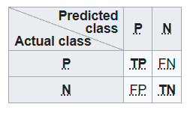
Evaluation Confusion Matrix
A confusion matrix is a table that is often used to describe the performance of a classification model (or "classifier") on a set of test data for which the true values are known.
The matrix contains four values as follows
TP -> number of true positives
FP -> number of false positives
TN -> number of true negatives
FN -> number of false negatives

Slide 24
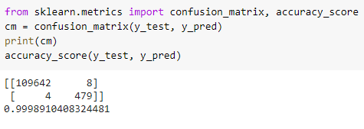
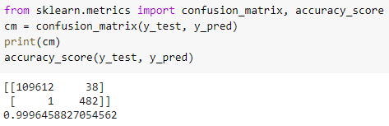
Evaluation Confusion Matrix
Logistic Regression
TP – 109642
FP – 4
FN – 8
TN – 479
Accuracy – 99.98%
C4.5 Decision Tree
TP – 109612
FP – 1
FN – 38
TN – 482
Accuracy – 99.96%

Slide 25
Evaluation Metrics
Precision: the ratio tp / (tp + fp). The precision is intuitively the ability of the classifier to not label a sample as positive if it is negative
Recall Ratio: the ratio tp / (tp + fn). The recall is intuitively the ability of the classifier to find all the positive samples.
F-Beta Score: is a weighted harmonic mean of the precision and recall, where an F-beta score reaches its best value at 1 and worst score at 0.
The support is the number of occurrences of each class in test dataset dependent variable.

Slide 26
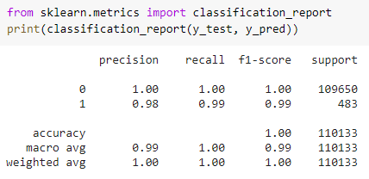
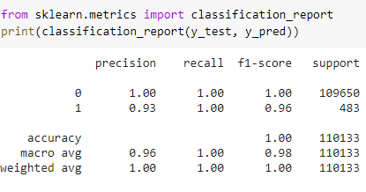
Evaluation Metrics
Logistic Regression Algorithm
C4.5 Decision Tree Algorithm

Slide 27
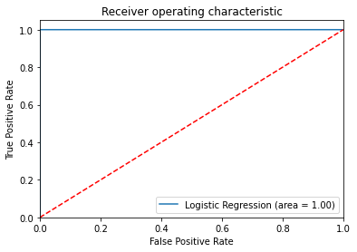
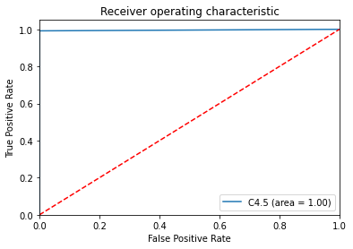
Evaluation ROC Curve
The receiver operating characteristic (ROC) curve where the dotted line represents the ROC curve of a purely random classifier; a good classifier stays as far away from that line as possible (toward the top-left corner).
Both the algorithm gave the similar output which can be confirmed once again based on the ROC curve

Slide 28
Deployment
Based on the metrics and the values obtained in the evaluation phase, both the algorithm seem to provide same results.
Both the algorithm can be deployed to predict if an individual is a possible entrepreneur or not
Only the people who are predicted to be a business owners can be approached for investment options and bank business loans
Census data can be used to deploy the model

Slide 29
References
https://towardsdatascience.com/building-a-logistic-regression-in-python-step-by-step-becd4d56c9c8
https://github.com/susanli2016/Machine-Learning-with-Python/blob/master/Logistic%20Regression%20balanced.ipynb
https://www.datacamp.com/community/tutorials/understanding-logistic-re
https://scikit-learn.org/stable/modules/tree.htmlgression-python
Notes from MIS 637 Machine Learning and Data analytics class
Udemy course materials- Machine Learning A-Z™: Hands-On Python & R In Data Science
https://people.ucsc.edu/~rfairlie/data/microdata/

Slide 30
Thank You!

